Slide 1


Fake Subsidy Allocation Classification
Submitted by
Debojyoti Sahu
Udit Narayan Sahoo
Biswajit Mandal
Under the supervision of Mr. Prasenjit Banerjee
MSASA 281
Term Project and Presentation II
Date: 25.05.2023

Slide 2



INTRODUCTION
Subsidy Income is a company who delivers subsidy to various customers according to their income level. A subsidy is basically a quantity of money given directly to companies, organizations or individuals by the Government, i.e. ,the taxpayer. Subsidies aim to encourage productions, boost exports and prevent a business from collapsing. Here Subsidy Income delivers subsidies to customers according to their need for business, productions or any other purpose. But the amount of subsidies are different according to the income level of each individual. So a person who has higher income level, may not get subsidy but a person whose income level is not good, get the subsidy for any kind of startup or any other purpose for income enhancement. In the modern world, collection of the correct information about the income of an individual is not easy. Many people don’t want to disclose the correct information about their income.

Slide 3
OBJECTIVE
The objective of this project is: -
Simplify the data system by reducing the number of variables to be studied, without sacrificing too much accuracy.
Reduce the number of misclassifications in the data.
Find the best algorithm among some algorithms according to the accuracy and number of misclassifications of this classification problem to find out accurate income of a person.

Slide 4
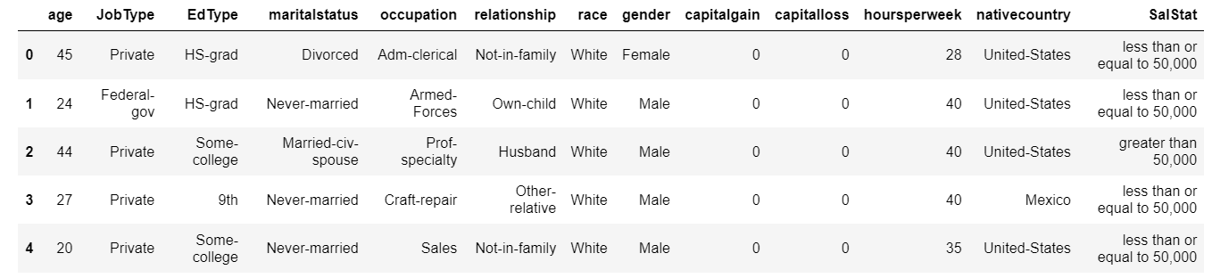
Dataset Description
The below dataset consists of annual income of a person along with age, job type, education level etc.
Some other parameters such as-
‘age’- age of individuals
‘Job Type’- type of their works
‘Ed Type’- individual’s educational qualification
‘marital status’- individuals are married or not
‘occupation’- occupation of individuals
‘relationship’- wheather an individual has family, children etc.
‘race’- race of the individual (skin colour of individual)
‘gender’- gender of individual
‘capital gain’- capital gain of individual(Profit while selling a property)
‘capital loss’- capital loss of individual(Loss while selling a property)
‘hours per week’- working hours per week of an individual
‘native country’- country every individual belongs to
‘Sal Stat’- income of each and every individual

Slide 5

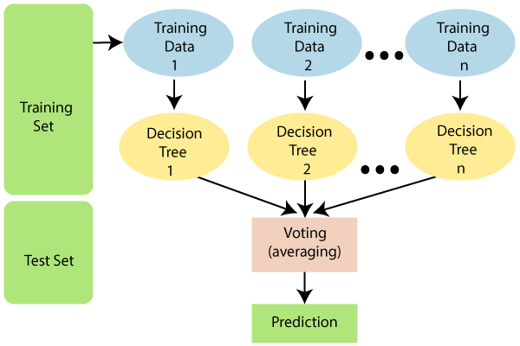
Methodology
1.DECISION TREE:
Here, the data is recursively split into subsets based on the most informative
features for predicting the target variable.
•Robust algorithm for binary classification tasks
•Better for Complex Feature Structures
•Can Handle Both Categorical and Continuous Data
•Have the tendency to overfit training data
2.RANDOM FOREST: Random Forest is a supervised algorithm that uses ensemble learning method consisting of a multitude of decision trees. •Each tree in a random forest is trained on a random subset of the training data •Can automatically identify important features in the data •Can handle both categorical and continuous data •Has a lower risk of overfitting compared to a single decision tree

Slide 6

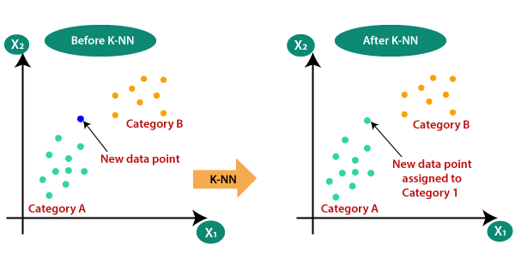
3.SVM: Support Vector Machine is a supervised learning algorithm that works by finding a hyperplane in a high- dimensional space that best separates the data into different classes. •Effective with more features •Highly dependent on Hyperparameters , such as kernel function •Computationally Expensive 4.KNN ALGORITHM:
K-NN algorithm assumes the similarity between the new case/data and available cases and put the new case into the category that is most similar to the available categories.
K-NN algorithm can be used for Regression as well as for Classification but mostly it is used for the Classification problems.
K-NN is a non-parametric algorithm, which means it does not make any assumption on underlying data.
KNN algorithm at the training phase just stores the dataset and when it gets new data, then it classifies that data into a category that is much similar to the new data

Slide 7
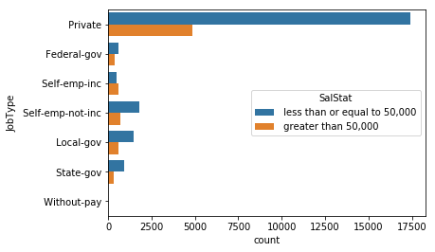
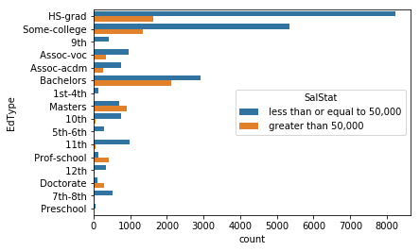
DATA ANALYSIS(GRAPHICALLY):
Job Type vs SalStat:
Ed Type vs SalStat:
According to the above diagram and table, 78.12% people working in private sectors, have income less than or equal to 50,000$. 55.86% people working as self-employed and income, earn greater than 50,000$.
74.6% people in Doctorate have income greater than 50000$ per annum.
56.4% people of Masters degree have greater than 50000$ per annum.
74.9% people of school professional people have income greater than 50000$ per annum.

Slide 8
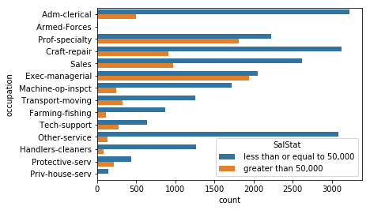
Occupation vs SalStat:
48.52% of people in Exec-managerial and 44.84% of people in prof-speciality are more likely to with income greater than 50000$ per annum. 99.3% of people in Priv-house-serv are more likely to have income less than or equal to 50,000$.

Slide 9
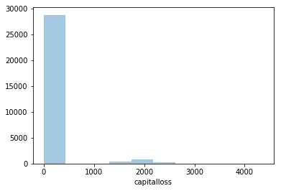
Capital gain vs SalStat:
Capital Loss vs SalStat:
95% of people have capital loss 0 i.e. either they have not invested anything or invested but have not had any loss according to the dataset.
92% of people have capital gain 0 but 8% people have gained profit from selling something according to the dataset.

Slide 10
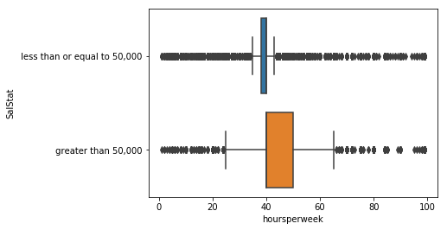
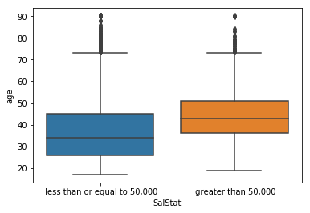
Hours per week vs SalStat:
Age and SalStat:
From the diagram it is clear that the people who have spent 40-50 hours per week are more likely to have salary greater than 50,000$ per annum.
People with age 35-50 income level greater than 50,000$ and
people with age 25-35 income level less than or equal to 50,000$ according to the dataset.

Slide 11

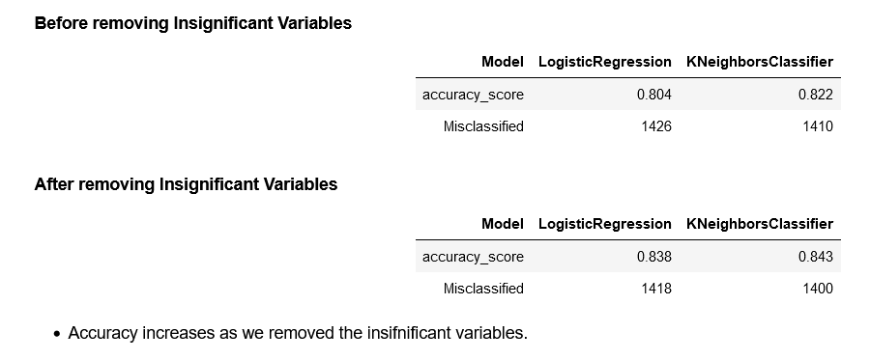
RESULT AND DISCUSSION
After creating training and testing set, logistic regression algorithm is applied on the training set and the accuracy is checked using the testing set. The validation accuracy becomes 80.4% and confusion matrix shows the number of misclassifications 1426. The accuracy using the training set is 83.8%. Both accuracies of using training and testing set are very closed to each other.

Slide 12

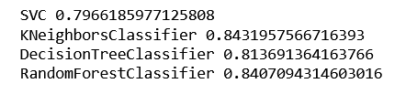
Accuracy Score:-

Slide 13

Conclusion :-
After using the K-NN classifier we can see that before removing the insignificant variables the misclassification values 1410 but after reducing the variables we get the values as 1400. Hence we can conclude that the misclassification in the data is reduced from the previous one .
After applying four major classification model SVC,KNN Classifier, Decision Tree Classifier, Random Forest Classifier we come to a conclusion that KNN Classifier gives the best value among all of them i.e. 0.8431957 and, Random Forest Classifier, Decision Tree Classifier , SVC 0.8407 ,0.8145201392342118 , 0.7966185977125808 respectively. The K-NN classifier fitted the best.

Slide 14
REFERENCES :-
Source of the data: https://archive.ics.uci.edu/ml/datasets/Census%2BIncome
Dataset: https://1drv.ms/x/s!AuOQjMBE9ClEdjyxMDW2kOLDi-k
Comparative Analysis of Classification Models on Income Prediction, by Bhavin Patel, V.Kakulapati, VVSSS Balaram, Sreenidhi Institute of Science & Technology, Yamnampet, Ghatkesar, Hydrabad, India.
Predicting Annual Income of Individual using Classification Techniques by Janmejay Mohanty , Stevens Institute of Technology.
Book: Practical Machine Learning with Python, by Dipanjan Sarkar, Raghav Bali, Tusar Sharma.

Slide 15

Thank you for your time and attention

